Slide 1
CS161 – Design and Architecture of Computer Systems
Week 3 – Discussion
*some slides adapted from:
Prof Daniel Wong UCR – EE/CS)

Slide 2
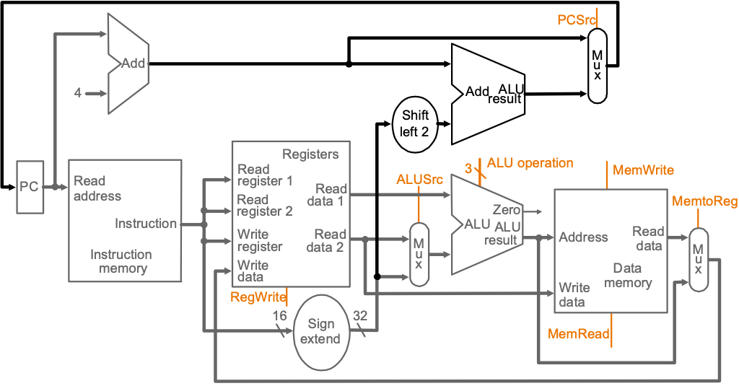
Multicycle
Divides operations into steps
One cycle per step
Critical Path: longest functional unit per step (i.e., PC+4 vs I-Mem)
IF
ID
EX
MEM
WB

Slide 3
Multicycle
Load = 5 cycles (IF, ID, EX, MEM, WB)
Store = 4 cycles (IF, ID, EX, MEM)
R-type = 4 cycles (IF, ID, EX, WB)
Branch = 3 cycles (IF, ID, EX)
Jump = 3 cycles (IF, ID, Jump)
0
Instruction
Fetch
1
Instruction
Decode
Start
Op = LW or SW
Op = R-type
Op = BEQ
Op = J
2
Mem. Address
Compute
6
ALU
Execute
8
Complete
Branch
9
Complete
Jump
Op = SW
Op = LW
3
Mem. Access
Read
5
Mem. Access
Write
7
Complete
R-type
4
Write-Back

Slide 4
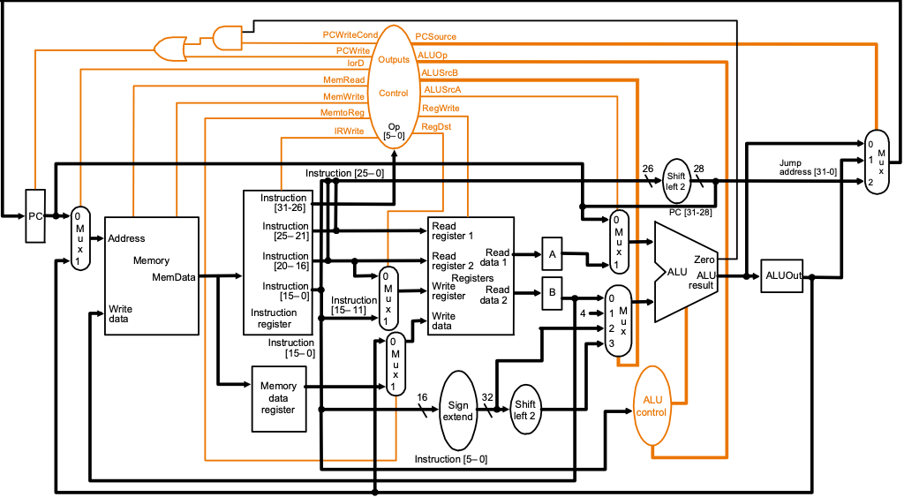
Control Signals
Notes:
Quickly.

Slide 5
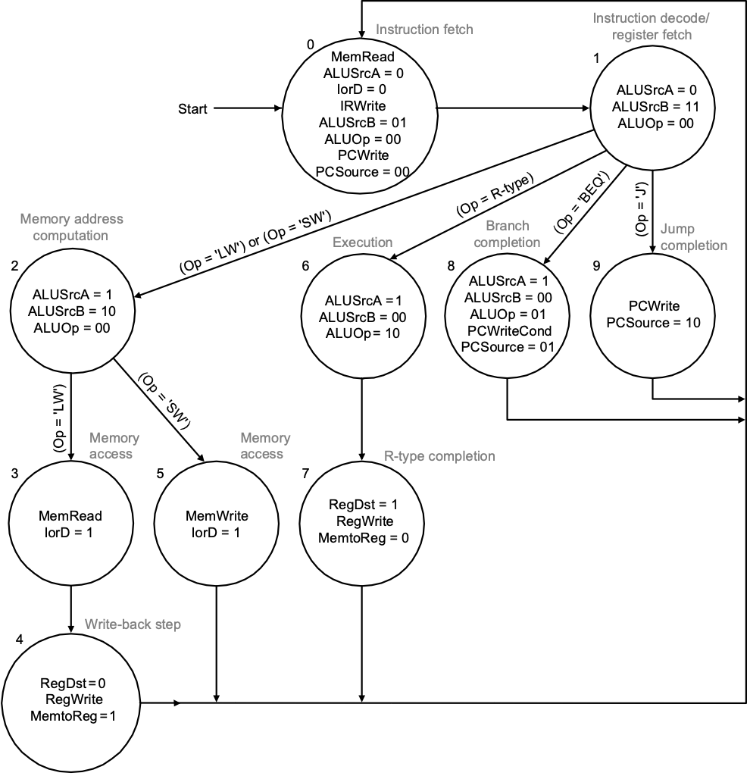
Multicycle
Load = 5 cycles (IF, ID, EX, MEM, WB)
Store = 4 cycles (IF, ID, EX, MEM)
R-type = 4 cycles (IF, ID, EX, WB)
Branch = 3 cycles (IF, ID, EX)
Jump = 3 cycles (IF, ID, Jump)

Slide 6
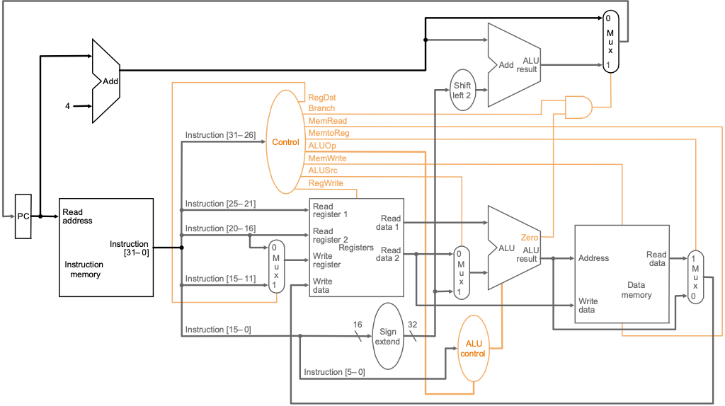
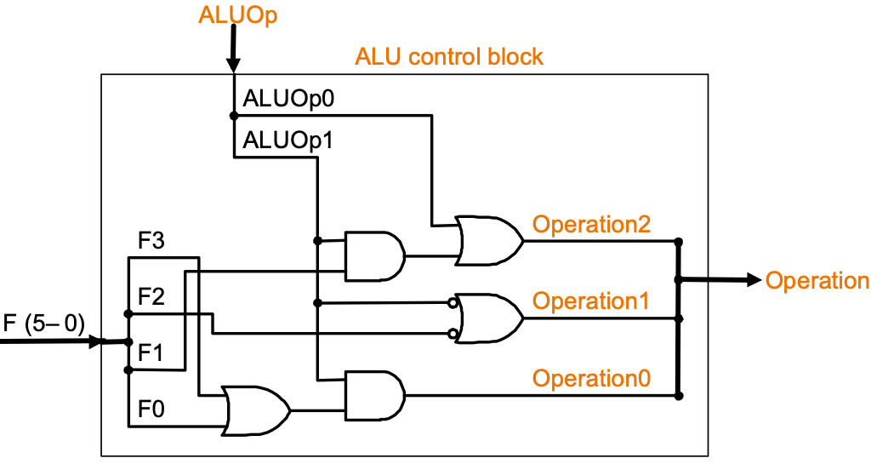
ALU Control Signals
ALU Control input
function field of the instruction
2-bit control field (ALUOp)
ALUOp indicates operation
(00) add - for loads and stores
(01) subtract - for beq
(10) determined by funct field
ALU Control output:
4-bit ALU control signal lines
Note: Operation3 used only for NOR function
Notes:
A confusing aspect of Figure D.2.2 is that there is no logic function for Operation3.
That is because this control line is only used for the NOR operation, which
is not needed for the MIPS subset in Figure 4.12

Slide 7
Control Signal Example: SWAP

Slide 8
Control Signal Example: SWAP
Add any necessary changes to datapath

Slide 9
Control Signal Example: SWAP

Slide 10
Control Signal Example: SWAP
Add any necessary changes to control signals

Slide 11
Control Signal Example: SWAP

Slide 12
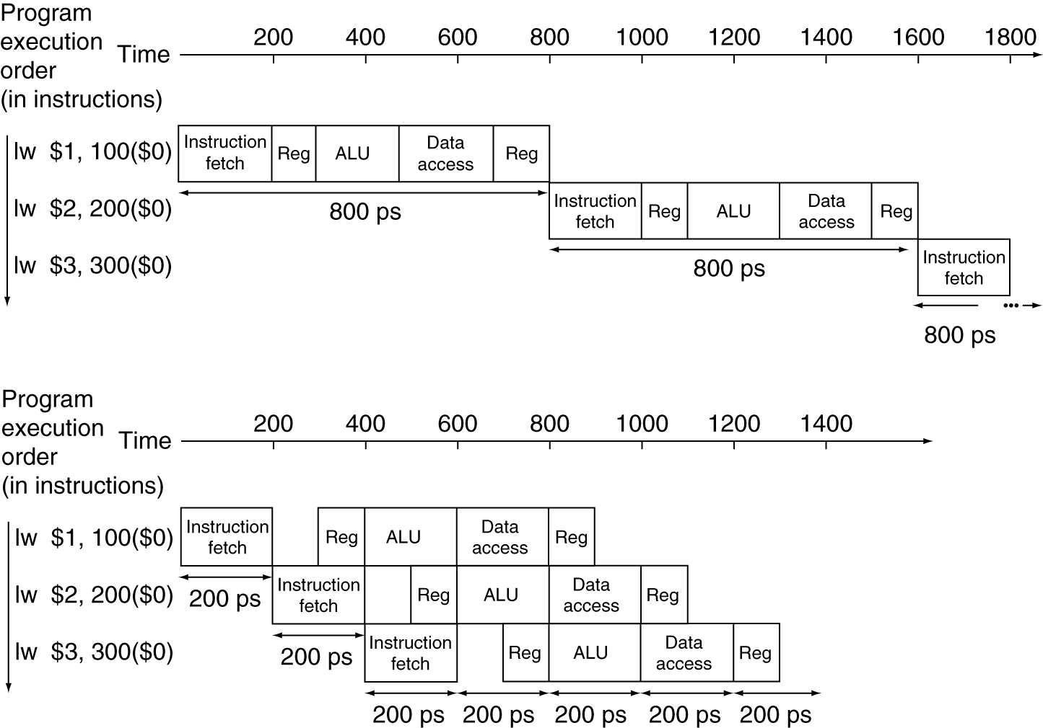
Multicycle → Pipeline
Single-cycle (T_{c}= 800ps)
Pipelined (T_{c}= 200ps)
We can overlap instructions

Slide 13
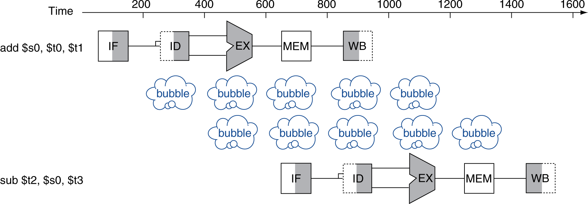
Problem: Account for Delays
$s0 data not ready
Need to stall

Slide 14
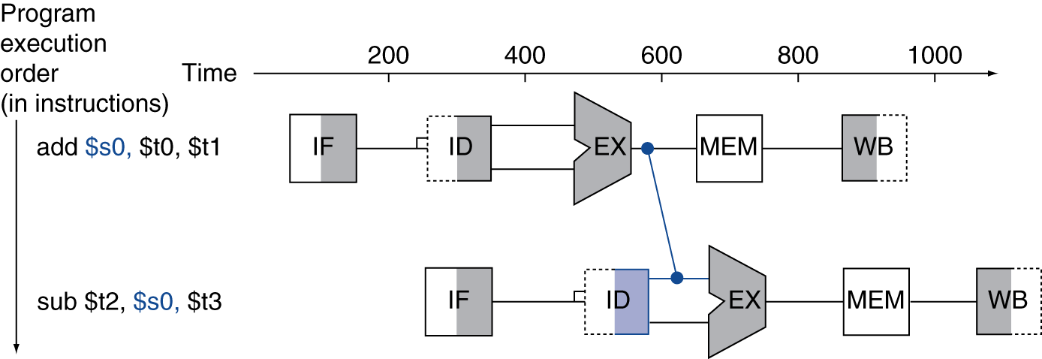
Solution: Forwarding
Forwarding
Forward data as soon as it’s available

Slide 15
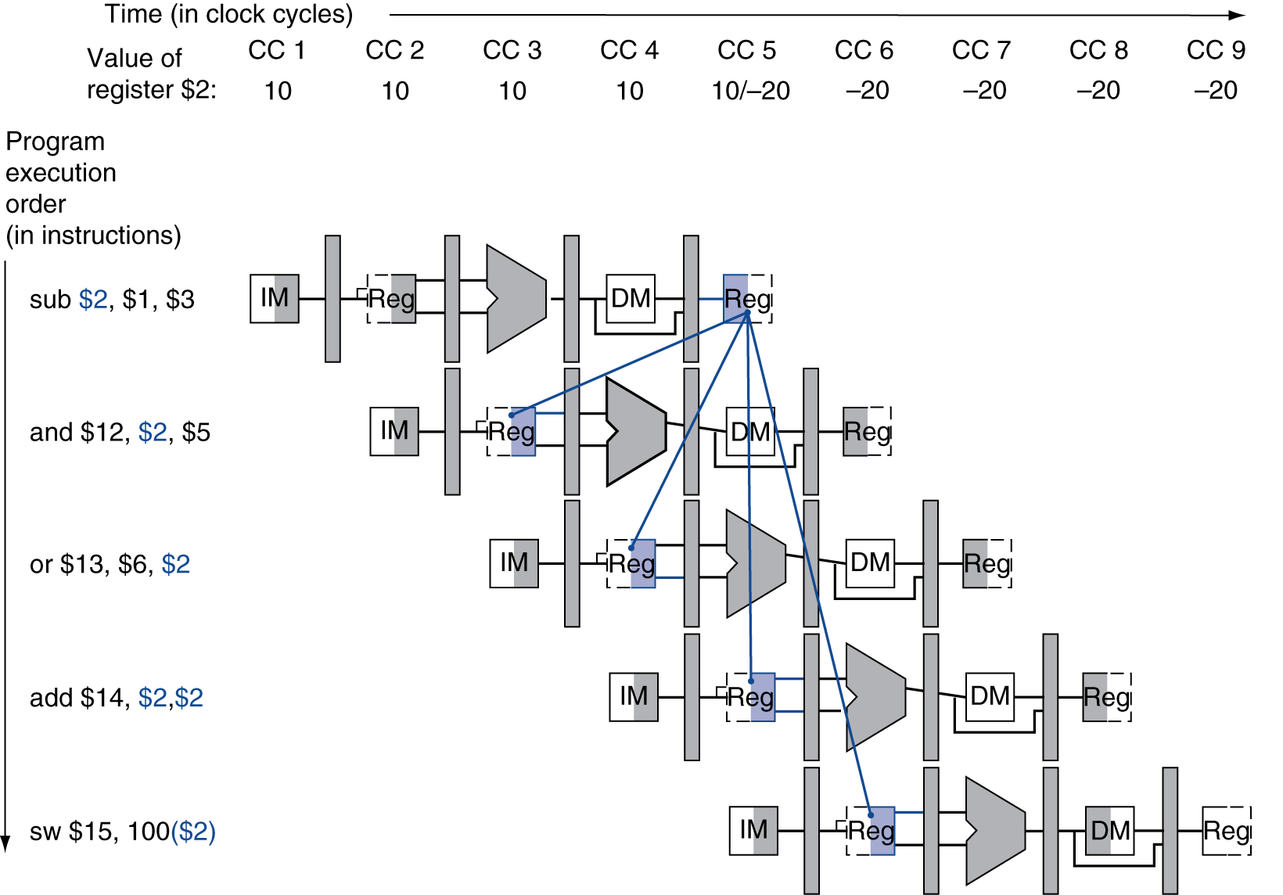
When to Forward
= Forwarding

Slide 16
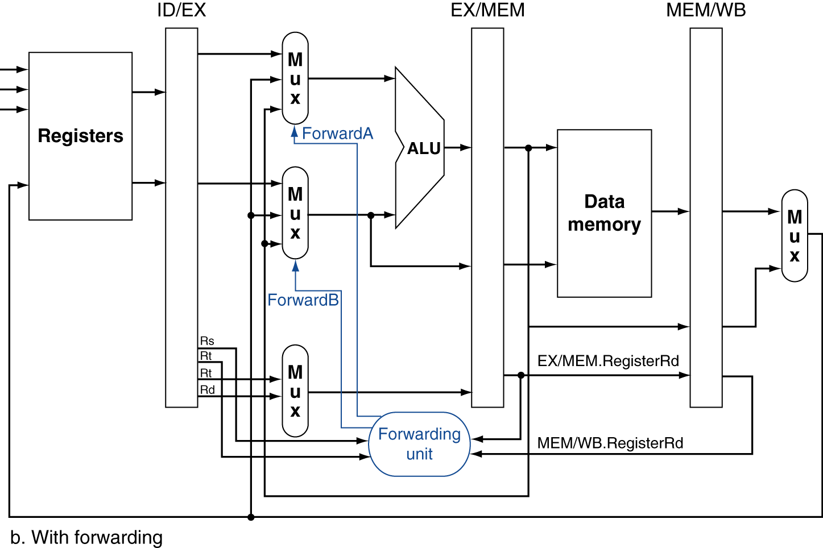
When to Forward
If dest == either src register
Fwd from EX/MEM pipeline reg
1a. EX/MEM.RegisterRd = ID/EX.RegisterRs
1b. EX/MEM.RegisterRd = ID/EX.RegisterRt
2a. MEM/WB.RegisterRd = ID/EX.RegisterRs
2b. MEM/WB.RegisterRd = ID/EX.RegisterRt
If dest == src register
Fwd from MEM/WB pipeline reg
rs
But only if forwarding instruction will write to register
EX/MEM.RegWrite
MEM/WB.RegWrite
rt
rd

Slide 17
With Forwarding
EX hazard
if (EX/MEM.RegWrite and (EX/MEM.RegisterRd ≠ 0) and (EX/MEM.RegisterRd = ID/EX.RegisterRs))
ForwardA = 10 (where b10 = #2)
rs
rt
rd

Slide 18
With Forwarding
EX hazard
if (EX/MEM.RegWrite and (EX/MEM.RegisterRd ≠ 0) and (EX/MEM.RegisterRd = ID/EX.RegisterRt))
ForwardB = 10 (where b10 = #2)
rs
rt
rd

Slide 19
With Forwarding
MEM hazard
if (MEM/WB.RegWrite and (MEM/WB.RegisterRd ≠ 0) and (MEM/WB.RegisterRd = ID/EX.RegisterRs))
ForwardA = 01 (where b01 = #1)
rs
rt
rd

Slide 20
With Forwarding
MEM hazard
if (MEM/WB.RegWrite and (MEM/WB.RegisterRd ≠ 0) and (MEM/WB.RegisterRd = ID/EX.RegisterRt))
ForwardB = 01 (where b01 = #1)
rs
rt
rd

Slide 21
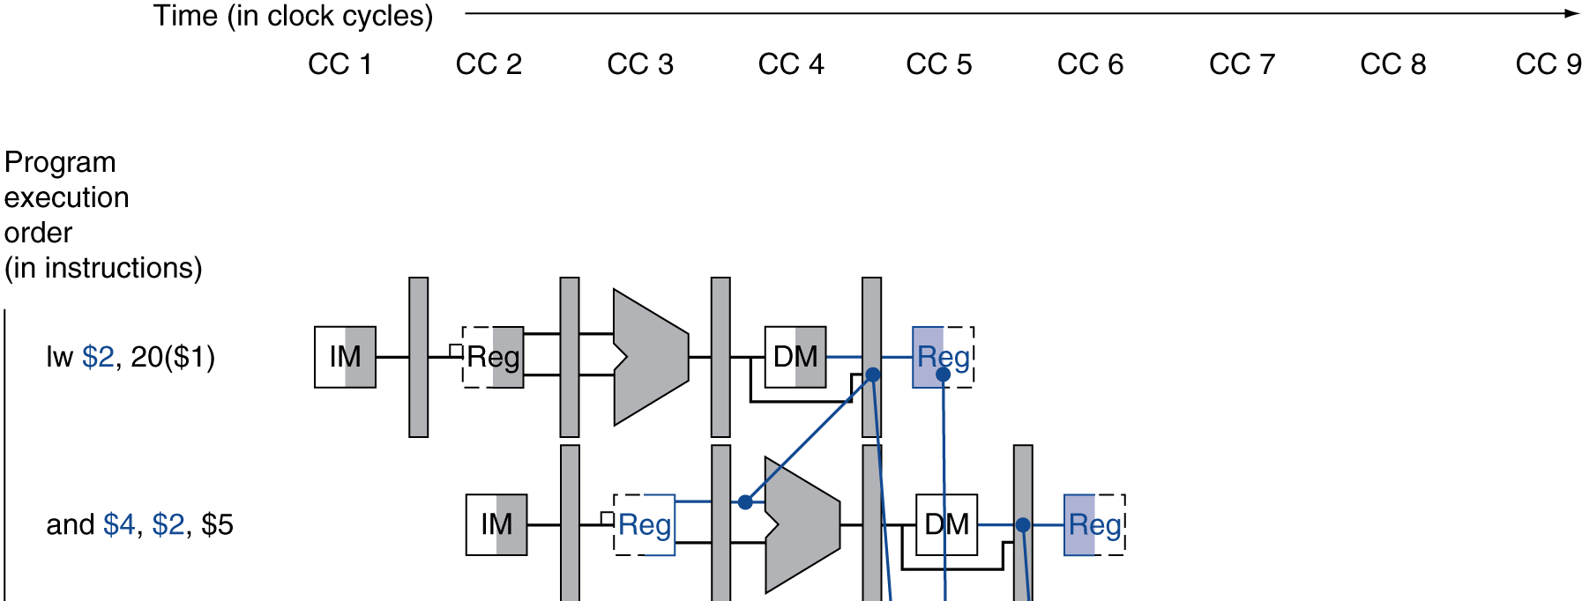
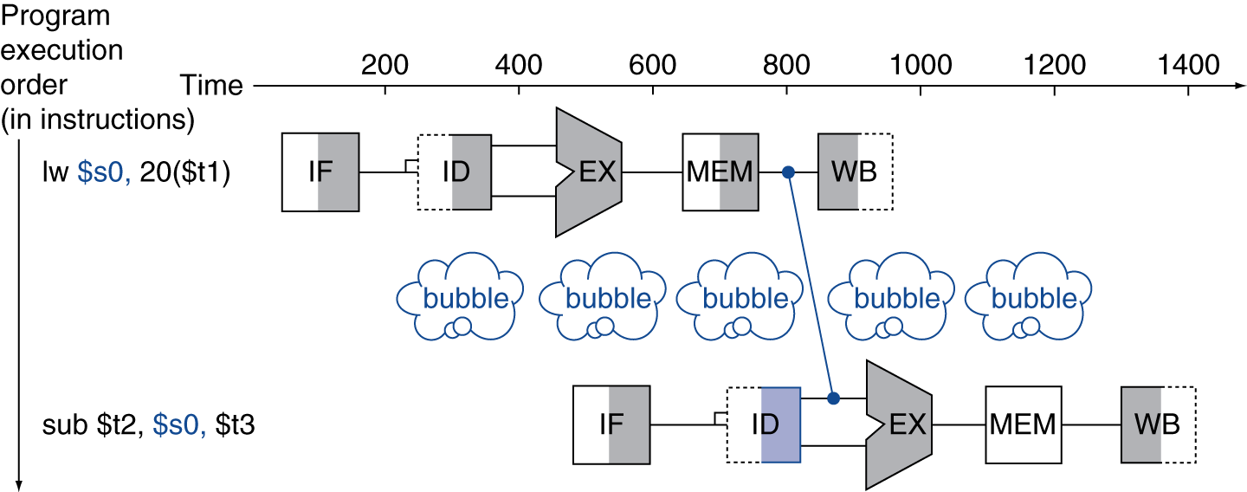
Still Can’t Avoid All Stalls
Can’t “forward” data backwards
Still need to stall for one cycle

Slide 22
Solution: LW Stalls
Instruction reordering to fill stalls
Stall
Stall

Slide 23
LW Forwarding Example 1
With no forwarding enabled
 | 1 | 2 | 3 | 4 | 5 | 6 | 7 | 8 | 9 | 10 | 11 | 12 | 13 | 14 | 15 | 16 | 17 | 18 | 19 | Comments
lw $t1, 0($t0)
lw $t2, 4($t0)
add $t3, $t1, $t2
sw $t3, 12($t0)
lw $t4, 8($t0)
add $t5, $t1, $t4
sw $t5, 16($t0)

Slide 24
LW Forwarding Example 1
With no forwarding enabled (dependencies)
 | 1 | 2 | 3 | 4 | 5 | 6 | 7 | 8 | 9 | 10 | 11 | 12 | 13 | 14 | 15 | 16 | 17 | 18 | 19 | Comments
lw $t1, 0($t0) | F | D | E | M | W
lw $t2, 4($t0) |  | F | D | E | M | W
add $t3, $t1, $t2 |  |  | F | - | - | D | E | M | W |  |  |  |  |  |  |  |  |  |  | Wait on $t2, stall 2 cycles
sw $t3, 12($t0) |  |  |  |  |  | F | - | - | D | E | M | W |  |  |  |  |  |  |  | Wait on $t3, stall 2 cycles
lw $t4, 8($t0) |  |  |  |  |  |  |  |  | F | D | E | M | W
add $t5, $t1, $t4 |  |  |  |  |  |  |  |  |  | F | - | - | D | E | M | W |  |  |  | Wait on $t4, stall 2 cycles
sw $t5, 16($t0) |  |  |  |  |  |  |  |  |  |  |  |  | F | - | - | D | E | M | W | Wait on $t5, stall 2 cycles

Slide 25
LW Forwarding Example 2
With forwarding enabled
 | 1 | 2 | 3 | 4 | 5 | 6 | 7 | 8 | 9 | 10 | 11 | 12 | 13 | 14 | 15 | 16 | 17 | 18 | 19 | Comments
lw $t1, 0($t0)
lw $t2, 4($t0)
add $t3, $t1, $t2
sw $t3, 12($t0)
lw $t4, 8($t0)
add $t5, $t1, $t4
sw $t5, 16($t0)

Slide 26
LW Forwarding Example 2
With forwarding enabled (dependencies – forwarding)
 | 1 | 2 | 3 | 4 | 5 | 6 | 7 | 8 | 9 | 10 | 11 | 12 | 13 | 14 | 15 | 16 | 17 | 18 | 19 | Comments
lw $t1, 0($t0) | F | D | E | M | W
lw $t2, 4($t0) |  | F | D | E | M | W
add $t3, $t1, $t2 |  |  | F | - | D | E | M | W |  |  |  |  |  |  |  |  |  |  |  | Forward $t2 from Mem/WB to Exec, Stall 1 cycle
sw $t3, 12($t0) |  |  |  |  | F | D | E | M | W |  |  |  |  |  |  |  |  |  |  | Forward $t3 from Exec/Mem to Exec.
lw $t4, 8($t0) |  |  |  |  |  | F | D | E | M | W
add $t5, $t1, $t4 |  |  |  |  |  |  | F | - | D | E | M | W |  |  |  |  |  |  |  | Forward $t4 from Mem/WB to Exec, Stall 1 cycle
sw $t5, 16($t0) |  |  |  |  |  |  |  |  | F | D | E | M | W |  |  |  |  |  |  | Forward $t5 from Exec/Mem to Exec.

Slide 27
LW Forwarding Example 3
With forwarding and reordering enabled
 | 1 | 2 | 3 | 4 | 5 | 6 | 7 | 8 | 9 | 10 | 11 | 12 | 13 | 14 | 15 | 16 | 17 | 18 | 19 | Comments
lw $t1, 0($t0)
lw $t2, 4($t0)
add $t3, $t1, $t2
sw $t3, 12($t0)
lw $t4, 8($t0)
add $t5, $t1, $t4
sw $t5, 16($t0)

Slide 28
LW Forwarding Example 3
With forwarding and reordering enabled (dependencies – forwarding)
 | 1 | 2 | 3 | 4 | 5 | 6 | 7 | 8 | 9 | 10 | 11 | 12 | 13 | 14 | 15 | 16 | 17 | 18 | 19 | Comments
lw $t1, 0($t0) | F | D | E | M | W
lw $t2, 4($t0) |  | F | D | E | M | W
lw $t4, 8($t0) |  |  | F | D | E | M | W
add $t3, $t1, $t2 |  |  |  | F | D | E | M | W |  |  |  |  |  |  |  |  |  |  |  | Forward $t2 from Mem/WB to Exec.
sw $t3, 12($t0) |  |  |  |  | F | D | E | M | W |  |  |  |  |  |  |  |  |  |  | Forward $t3 from Exec/Mem to Exec.
add $t5, $t1, $t4 |  |  |  |  |  | F | D | E | M | W
sw $t5, 16($t0) |  |  |  |  |  |  | F | D | E | M | W |  |  |  |  |  |  |  |  | Forward $t5 from Exec/Mem to Exec.

Slide 29
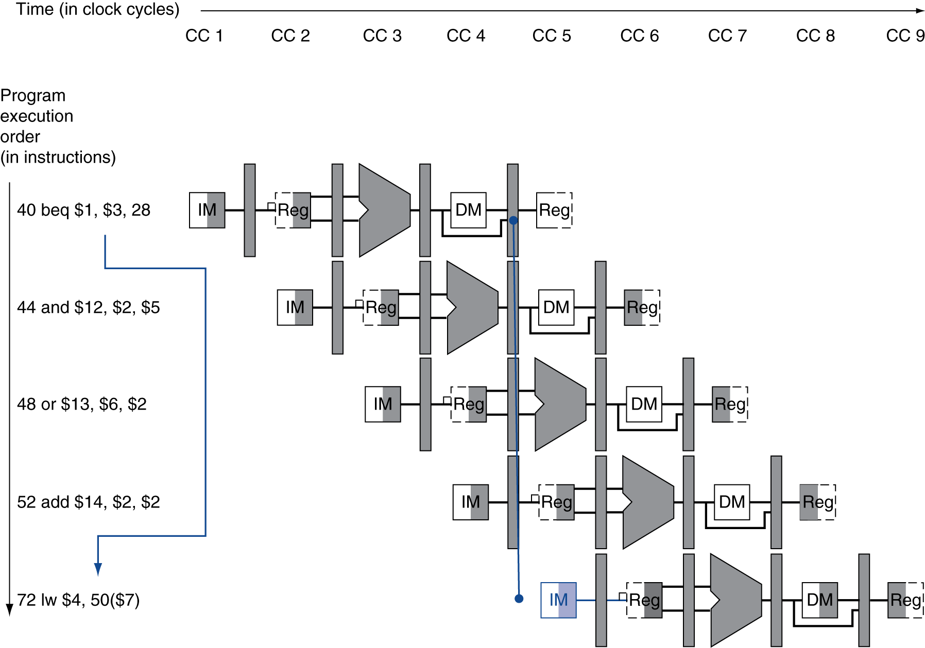
Problem: Branch Hazard
If branch determined in MEM
Flush these instructions

Slide 30
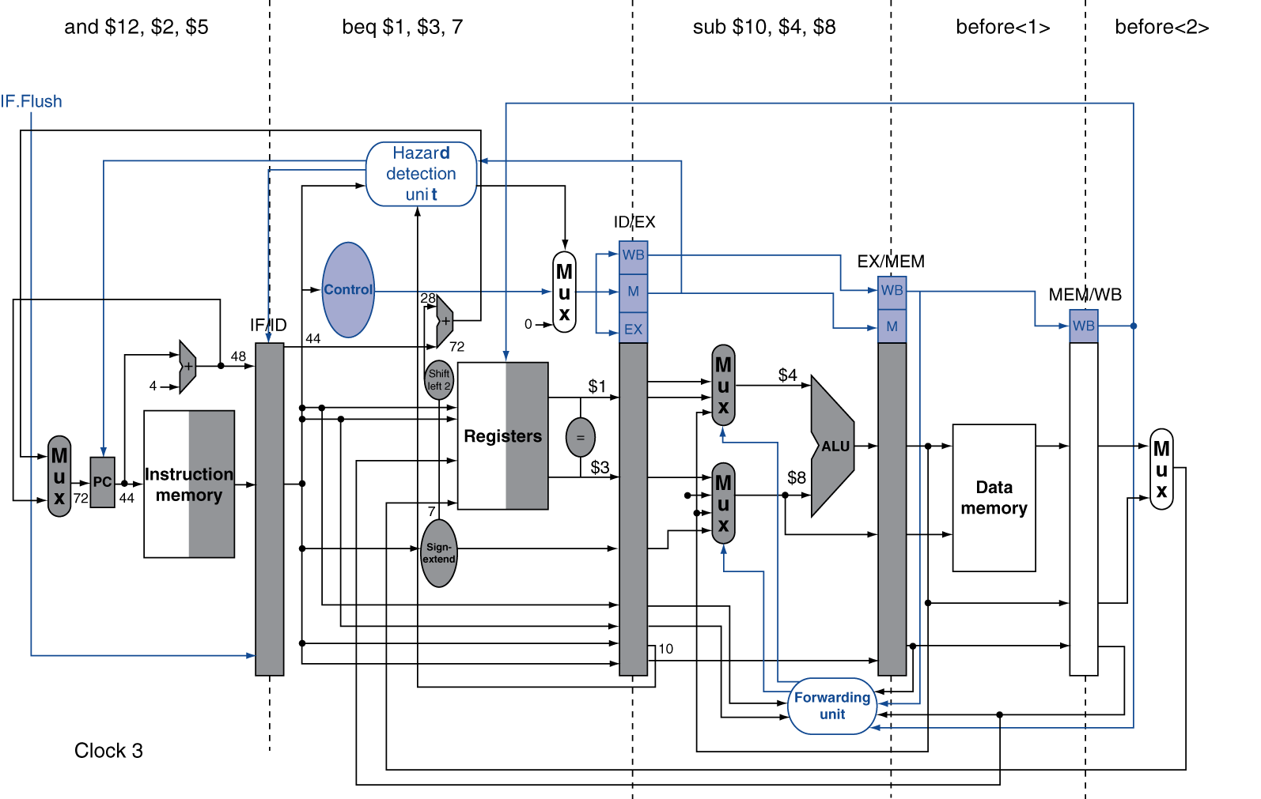
Solution: Branch Hazard
Move hardware determine outcome in ID stage
Target address adder
Register comparator
Use branch prediction (history of branches) & instruction reordering

Slide 31
Branch Forwarding Example 1
Branches resolve in MEM, with forwarding enabled. Assume stall on branch (i.e., no branch predictor)
Branch Taken case
 | 1 | 2 | 3 | 4 | 5 | 6 | 7 | 8 | 9 | 10 | 11 | 12 | 13 | Comments
lw $t1, 8($t2)
add $t4, $t5, $t6
beq $t1, $t4, tgt
add $t1, $t3, $t2
add $t5, $t1, $t4
add $t3, $t2, $t4
tgt: lw $t1, 8($t2)

Slide 32
Branch Forwarding Example 1
Branches resolve in MEM, with forwarding enabled. Assume stall on branch (i.e., no branch predictor)
Branch Taken case
 | 1 | 2 | 3 | 4 | 5 | 6 | 7 | 8 | 9 | 10 | 11 | 12 | 13 | Comments
lw $t1, 8($t2) | F | D | E | M | W
add $t4, $t5, $t6 |  | F | D | E | M | W
beq $t1, $t4, tgt |  |  | F | D | E | M | W |  |  |  |  |  |  | Cycle 5, forward $t1 and $t4
add $t1, $t3, $t2 |  |  |  | - | - |  |  |  |  |  |  |  |  | (Stall 2 cycles on branch)
add $t5, $t1, $t4
add $t3, $t2, $t4
tgt: lw $t1, 8($t2) |  |  |  |  |  | F | D | E | M | W |  |  |  | Fetch target in cycle 6 because branch is now resolved

Slide 33
Branch Forwarding Example 2
Branches resolve in MEM with forwarding enabled. Assume no stall on branch, so next instruction can be fetched right after branch (i.e., branch predictor). Assume always not-taken predictor.
Branch Taken case
 | 1 | 2 | 3 | 4 | 5 | 6 | 7 | 8 | 9 | 10 | 11 | 12 | 13 | Comments
lw $t1, 8($t2)
add $t4, $t5, $t6
beq $t1, $t4, tgt
add $t1, $t3, $t2
add $t5, $t1, $t4
add $t3, $t2, $t4
tgt: lw $t1, 8($t2)

Slide 34
Branch Forwarding Example 2
Branches resolve in MEM with forwarding enabled. Assume no stall on branch, so next instruction can be fetched right after branch (i.e., branch predictor). Assume always not-taken predictor.
Branch Taken case
 | 1 | 2 | 3 | 4 | 5 | 6 | 7 | 8 | 9 | 10 | 11 | 12 | 13 | Comments
lw $t1, 8($t2) | F | D | E | M | W
add $t4, $t5, $t6 |  | F | D | E | M | W
beq $t1, $t4, tgt |  |  | F | D | E | M | W |  |  |  |  |  |  | Cycle 5, forward $t1 and $t4
add $t1, $t3, $t2 |  |  |  | F | D |  |  |  |  |  |  |  |  | Branch predicted as not-taken
add $t5, $t1, $t4 |  |  |  |  | F
add $t3, $t2, $t4
tgt: lw $t1, 8($t2) |  |  |  |  |  | F | D | E | M | W |  |  |  | Fetch target in cycle 6 because branch is now resolved

Slide 35
Branch Forwarding Example 3
Branches resolve in MEM, with forwarding enabled. Assume stall on branch (i.e., no branch predictor)
Branch Not Taken case
 | 1 | 2 | 3 | 4 | 5 | 6 | 7 | 8 | 9 | 10 | 11 | 12 | 13 | Comments
lw $t1, 8($t2)
add $t4, $t5, $t6
beq $t1, $t4, tgt
add $t1, $t3, $t2
add $t5, $t1, $t4
add $t3, $t2, $t4
tgt: lw $t1, 8($t2)

Slide 36
Branch Forwarding Example 3
Branches resolve in MEM, with forwarding enabled. Assume stall on branch (i.e., no branch predictor)
Branch Not Taken case
 | 1 | 2 | 3 | 4 | 5 | 6 | 7 | 8 | 9 | 10 | 11 | 12 | 13 | Comments
lw $t1, 8($t2) | F | D | E | M | W
add $t4, $t5, $t6 |  | F | D | E | M | W
beq $t1, $t4, tgt |  |  | F | D | E | M | W |  |  |  |  |  |  | Cycle 5, forward $t1 and $t4
add $t1, $t3, $t2 |  |  |  | - | - | F | D | E | M | W |  |  |  | Branch resolves in cycle 6 (Stall 2 cycles on branch)
add $t5, $t1, $t4 |  |  |  |  |  |  | F | D | E | M | W
add $t3, $t2, $t4 |  |  |  |  |  |  |  | F | D | E | M | W
tgt: lw $t1, 8($t2) |  |  |  |  |  |  |  |  | F | D | E | M | W

Slide 37
Branch Forwarding Example 4
Branches resolve in MEM, with forwarding enabled. Assume no stall on branch, so next instruction can be fetched right after branch (i.e., branch predictor). Assume always taken predictor.
Branch Not Taken case
 | 1 | 2 | 3 | 4 | 5 | 6 | 7 | 8 | 9 | 10 | 11 | 12 | 13 | Comments
lw $t1, 8($t2)
add $t4, $t5, $t6
beq $t1, $t4, tgt
add $t1, $t3, $t2
add $t5, $t1, $t4
add $t3, $t2, $t4
tgt: lw $t1, 8($t2)

Slide 38
Branch Forwarding Example 4
Branches resolve in MEM, with forwarding enabled. Assume no stall on branch, so next instruction can be fetched right after branch (i.e., branch predictor). Assume always taken predictor.
Branch Not Taken case
 | 1 | 2 | 3 | 4 | 5 | 6 | 7 | 8 | 9 | 10 | 11 | 12 | 13 | Comments
lw $t1, 8($t2) | F | D | E | M | W
add $t4, $t5, $t6 |  | F | D | E | M | W
beq $t1, $t4, tgt |  |  | F | D | E | M | W |  |  |  |  |  |  | Cycle 5, forward $t1 and $t4
add $t1, $t3, $t2 |  |  |  |  |  | F | D | E | M | W |  |  |  | Branch resolved in cycle 6. Misprediction!
add $t5, $t1, $t4 |  |  |  |  |  |  | F | D | E | M | W
add $t3, $t2, $t4 |  |  |  |  |  |  |  | F | D | E | M | W
tgt: lw $t1, 8($t2) |  |  |  | F | D |  |  |  |  |  |  |  |  | (assumes branch taken)

Slide 39
Practice Midterm

Slide 40
Practice Midterm
Notes:
Since the largest instruction type (Load) takes 8 ns, then the clock cycle time for a single cycle must be 8 ns.
For a single cycle, there is only one cycle for each instruction, and since CPI = cycles/instruction, then CPI = 1 for single cycle

Slide 41
Practice Midterm

Slide 42
Practice Midterm
R-type = 4 cycles (IF, ID, EX, WB) → 4*.4
Load = 5 cycles (IF, ID, EX, MEM, WB) → 5*.2
Store = 4 cycles (IF, ID, EX, MEM) → 4*.1
Branch = 3 cycles (IF, ID, EX) → 3*.2
Jump = 3 cycles (IF, ID, Jump) → 3*.1
Notes:
R-type need 4 cycles (IF, ID, EX, WB) → 4*.4
Load has 5 cycles (IF, ID, EX, MEM, WB) → 5*.2
Store need 4 cycles (IF, ID, EX, MEM) → 4*.1
Branch has 3 cycles (IF, ID, EX) → 3*.2
Jump has 3 cycles (IF, ID, Jump) → 3*.1

Slide 43
Practice Midterm

Slide 44
Practice Midterm
$$clock cycle= \frac{1}{clock rate}= \frac{1}{500 MHz}= \frac{1}{500∗{10}^{6}}=\frac{1}{0.5∗{10}^{9}}=2∗{10}^{−9}=2 ns$$
$$CPU time=clock cycle ∗CPI ∗I=2 ns ∗3.9 ∗100=780ns$$
Notes:
CPU Time = clock cycles * (CPI * Instruction Count) = (CPI * Instruction Count) / clock rate
clock cycle = 1/(clock rate) = 1/(500 MHz) = 1/(500*10^6) = 1/(0.5*10^9) = 2*10^(-9) = 2 ns

Slide 45
Practice Midterm

Slide 46
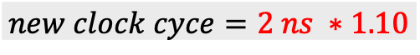
Practice Midterm
$$new CPI=4\left(.4\right)+5\left(.1\right)+4\left(.1\right)+3\left(.2\right)+3\left(.1\right)=3.4$$
$$new clock cyce=2 ns ∗1.10$$
$$CPU time=clock cycle ∗CPI ∗I=2 ns ∗ 1.10 ∗3.4 ∗100=748ns$$

Slide 47
Practice Midterm

Slide 48
Practice Midterm

Slide 49
Practice Midterm

Slide 50
Practice Midterm

Slide 51
Practice Midterm

Slide 52
Practice Midterm

Slide 53
Practice Midterm

Slide 54
Practice Midterm

Slide 55
Practice Midterm

Slide 56
Practice Midterm
0
1
2

Slide 57
Practice Midterm

Slide 58
Practice Midterm

